Slide 1

CAR DATA ANALYSIS
DIVYANSH KUMAR GUPTA

Slide 2
Business Objective
The objective is to analyse the car dataset to gain insights into popular trends and identifing key factors for launching promising car models.

Slide 3

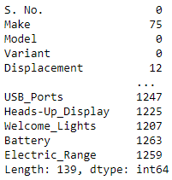
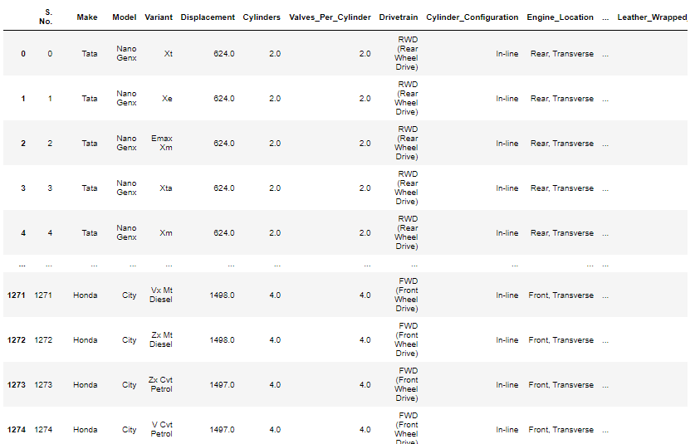

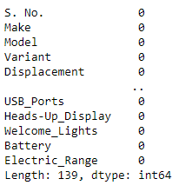
Data Understanding & Preprocessing
Before
After

Slide 4
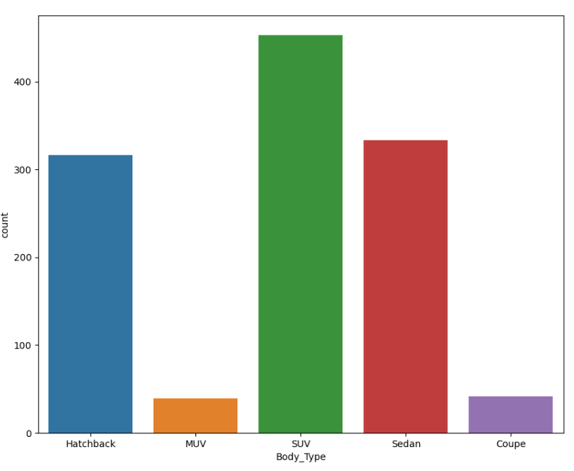
Top 10 preferred body types
Car that has body types as 'SUV' is preffered the most and 'Sedan is the 2nd most preffered body types.

Slide 5
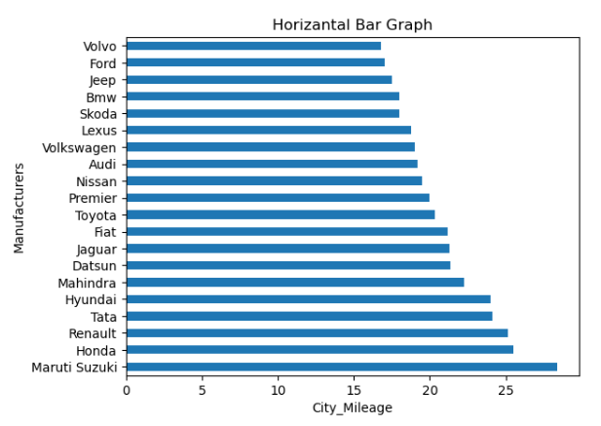
Top 20 Non-Electric Manufacturers wise City Mileage
Maruti Suzuki is the top non electric car manufacturer that has the maximum city mileage of 28.40, Honda at the second place with highest mileage of 25

Slide 6
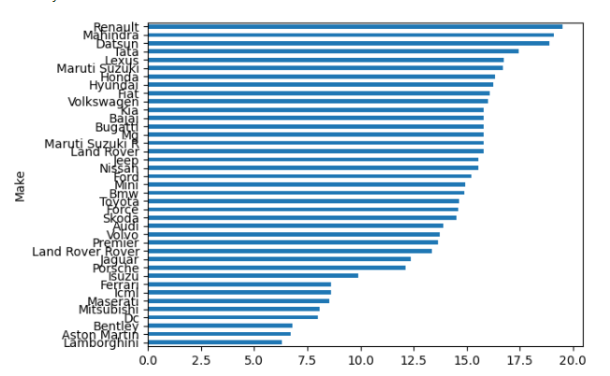
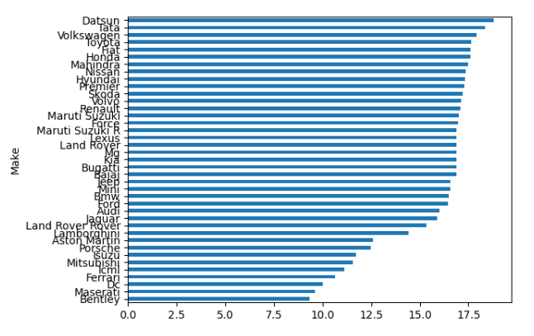
Manufacturer wise average of city mileage and median of city mileage
Average City Mileage
Average Highway Mileage
Renault manufactures the highest average of city mileage in cars and Datsun manufactures the highest average in highway mileage in cars

Slide 7
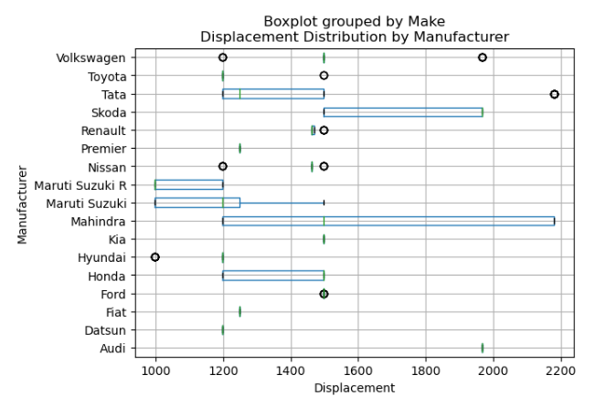
Manufacturers Wise top 10 Count of Displacements
Among the top 10 displacement range of counts 'Tata' has the highest displacement with a right skewness present in it.

Slide 8
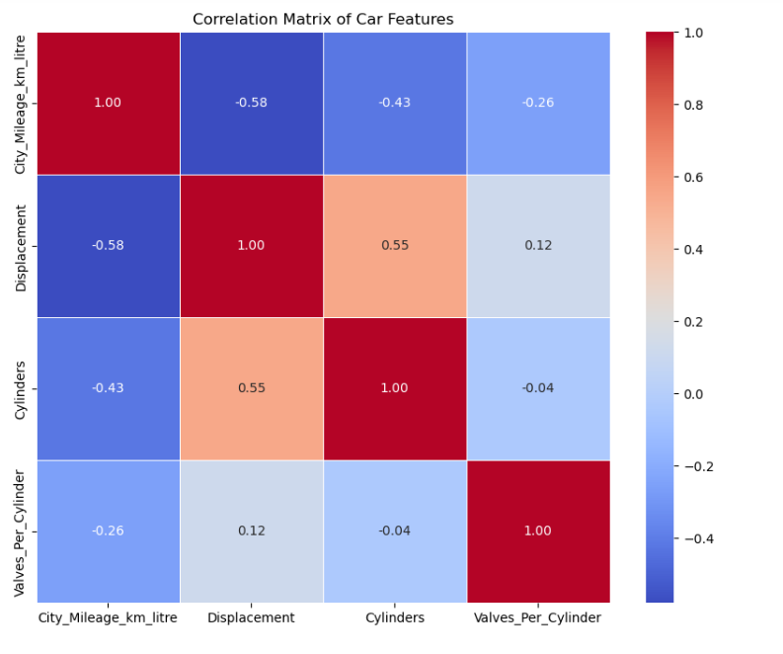
Correlation Of Features For Renaults, Toyota and Honda
The visual shows that theres a negative relationship between city mileage and displacement, cylinders, valves per cylinder.

Slide 9
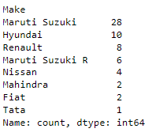
Manufacturers with the presence of safety features such as ABS, airbags and hill assist, to assess the safety of various car models.
Maruti Suzuki manufactures the highest number of safe cars in terms of hill assistance, anti lock braking system and airbags. Hyundai is the second safest car manufacturers.

Slide 10
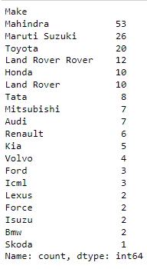
Explore seating capacity, central locking and child safety locks to understand user comfort and family friendly features.
Mahindra manufactures the highest number of cars with seating capacity , central locking and child lock system, Maruti Suzuki is at the second place and Toyota at the third place.

Slide 11
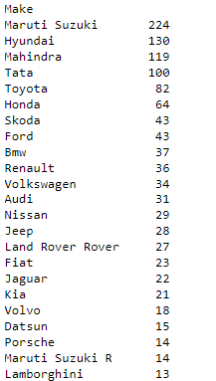
Investigate the presence of high-speed alerts, seat belt reminders, and door ajar warnings to assess the integration of safety and convenience features.
Maruti Suzuki is manufacturing the highest count of models in cars with high Alert system.

Slide 12
Conclusion
The data analysis reveals several key insights into the automobile industry. Firstly, 'SUV' emerges as the most preferred body type for cars. Maruti Suzuki dominates in manufacturing cars with different driving modes, including comfort, eco, sport, and power modes. Mahindra leads in producing cars with high city mileage, although caution is warranted due to potential outliers. 'Renault' stands out with the highest average city mileage, while 'Mahindra' excels in average highway mileage. In terms of safety features, Maruti Suzuki leads the pack, followed by Hyundai. Tata displays a right-skewed distribution in city mileage, and among the top 10 displacement ranges, Tata has the highest displacement. Visuals illustrate a negative relationship between city mileage and displacement, cylinders, and valves per cylinder. Additionally, manufacturers like 'Tata,' 'Renault,' and 'Maruti Suzuki' are recognized for advanced alert systems. Tata, Maruti Suzuki, and Bentley manufacture cars with notable dimensions, while Mahindra excels in producing cars with features like seating capacity, central locking, and child lock systems.

Slide 13
Thankyou

